Slide 1
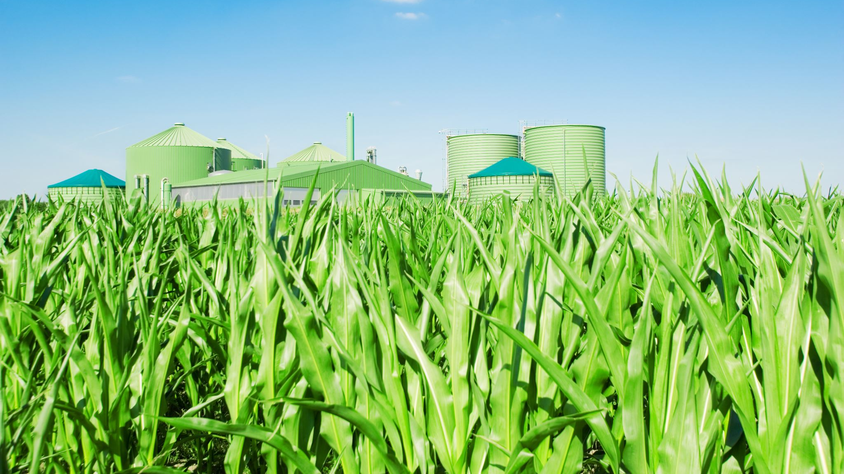
BIOGAS
(The new source of energy)

Slide 2
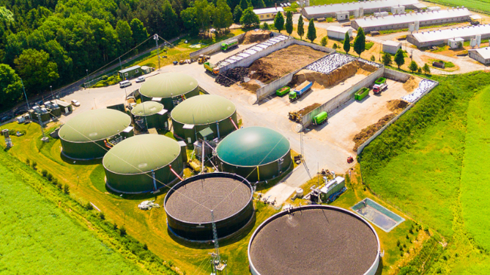
HISTORY OF BIOGAS
Biogas history spans from ancient use in 10th century BC Assyria to modern renewable energy with major milestones including Jan Baptista Helmont identifying flammable gas from decay in the 17th century, the first Indian digester in 1859, and 1895 street lighting in Exter, UK. The 20th century, particularly the 1970s energy crisis, spurred widespread adoption.

Slide 3
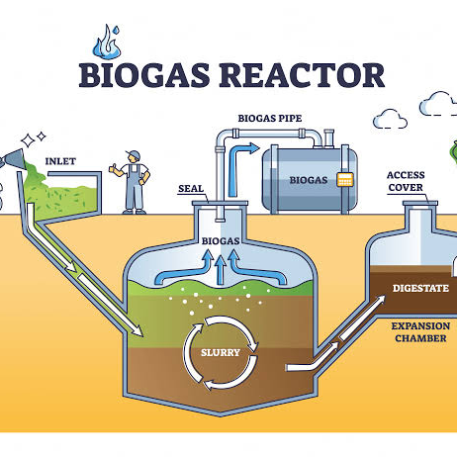
WHAT IS BIOGAS?
Biogas is a renewable energy source created from the beakdown of organic waste (like food scraps, manure, sewage) by microbers in an oxygen-free environment (anaerobic digestion), primarily producing flammable methane and carbon dioxide.

Slide 4
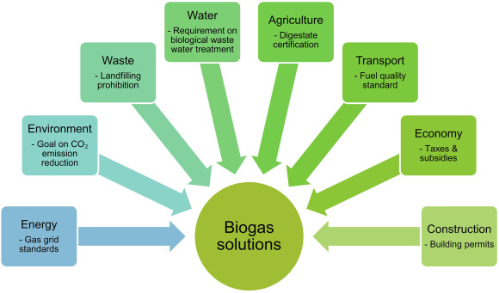
FEATURES OF BIOGAS
Renewable energy source – produced from organic waste like food waste, animal dung, and sewage.
Eco-friendly – reduces greenhouse gas emissions and environmental pollution.
Clean-burning fuel – produces less smoke and fewer harmful gases than firewood or coal.
Waste management solution – converts waste into useful energy.
Cost-effective – reduces dependence on fossil fuels and lowers energy costs over time.
Produces organic fertilizer – the leftover slurry is rich in nutrients and improves soil quality.
Suitable for rural and urban areas – can be used at household, community, or industrial levels.
Improves sanitation and hygiene – reduces open dumping of waste.
Versatile use – can be used for cooking, electricity generation, and heating.

Slide 5

ADVANTAGES OF BIOGAS
Renewable source of energy – continuously produced from organic waste.
Environment-friendly – reduces air pollution and greenhouse gas emissions.
Effective waste management – converts organic waste into useful energy.
Reduces dependence on fossil fuels – saves LPG, coal, and firewood.
Low-cost fuel – uses locally available materials and lowers energy expenses.
Produces valuable organic fertilizer – biogas slurry improves soil fertility.
Improves sanitation and public health – reduces waste accumulation and disease risk.
Supports rural development – provides energy, employment, and income opportunities.
Clean and efficient – burns with minimal smoke and odor.
Reduces deforestation – lowers the need for firewood.

Slide 6
TURNING WASTE INTO POWER FOR NIGERIA
NIGERIA known as the “Giant of Africa” is recognized for having over 200 million people, making it the most populous country in Africa and the 6th most populated in the world. It is characterized by rapid urbanization and significant economic activity, which have led to immense waste management challenges.

Slide 7
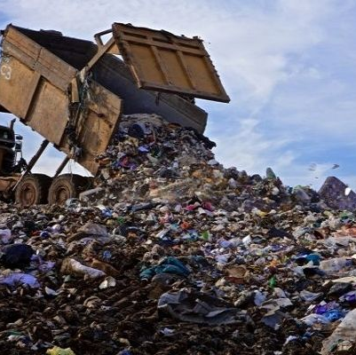
WASTE TO POWER
Nigeria generates millions of tons of waste every year, including food waste, agricultural residues, animal dung, and sewage. Most of this waste is poorly managed and ends up in open dumps, waterways, or landfills, causing environmental pollution, health risks, and greenhouse gas emissions. However, this same waste is a valuable resource. Through biogas technology, organic waste can be converted into cean energy for cooking, electricity, and heating, while also producing organic fertilizer. By turning waste into biogas, Nigeria can reduce pollution, improve sanitation, create jobs, and expand access to affordable, sustainable energy especially in rural and undeserved communities.

Slide 8
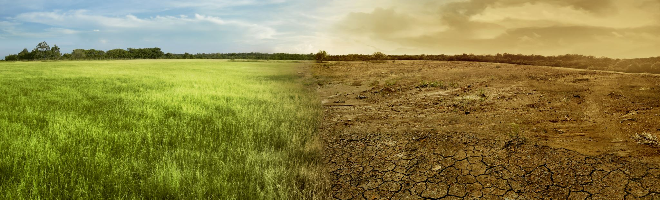
FROM WASTE TO WEALTH- POWERING INDIA
India is the world's second-most populous country with a rapidly growing economy and a high dependence on imported fossil fuels. With a massive agricultural sector and the world's largest cattle population, India has immense, untapped potential for bioenergy.

Slide 9
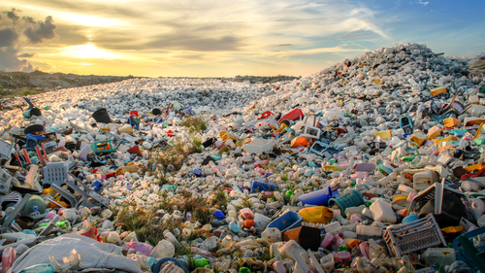
BIOGAS: POWERING AMERICA FORWARD
"America" (referring to the United States) is the world's largest producer of waste, generating significantly more trash per person than any other nation. It is a developed nation with a high-consumption "throwaway" economy that produces vast amounts of municipal solid waste (MSW)—including packaging, food, and plastics—as well as industrial and hazardous waste.

Slide 10
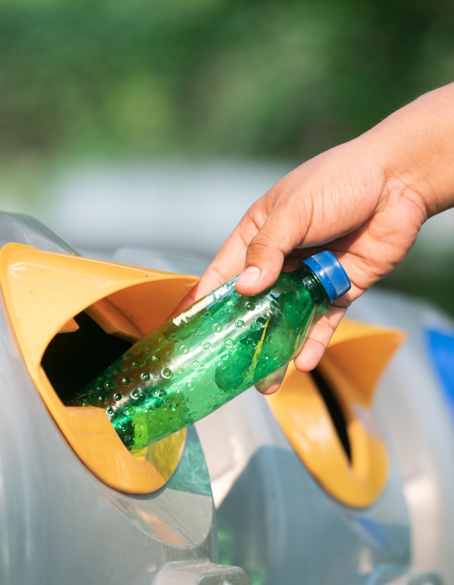
HOW TO IMPLEMENT BIOGAS IN OUR SOCIETY
Our Society can implement a biogas system by first identifying and collecting organic waste generated within the community, such as kitchen waste, food leftovers, animal dung, garden waste, and sewage. This waste should be segregated at the source to ensure only biodegradable materials are used.
A community-scale biogas plant can then be constructed at a suitable central location with proper access to water and safety measures. The collected organic waste is fed into an anaerobic digester, where it decomposes in the absence of oxygen to produce biogas. The biogas can be piped for community cooking facilities, street lighting, or small-scale electricity generation.

Slide 11
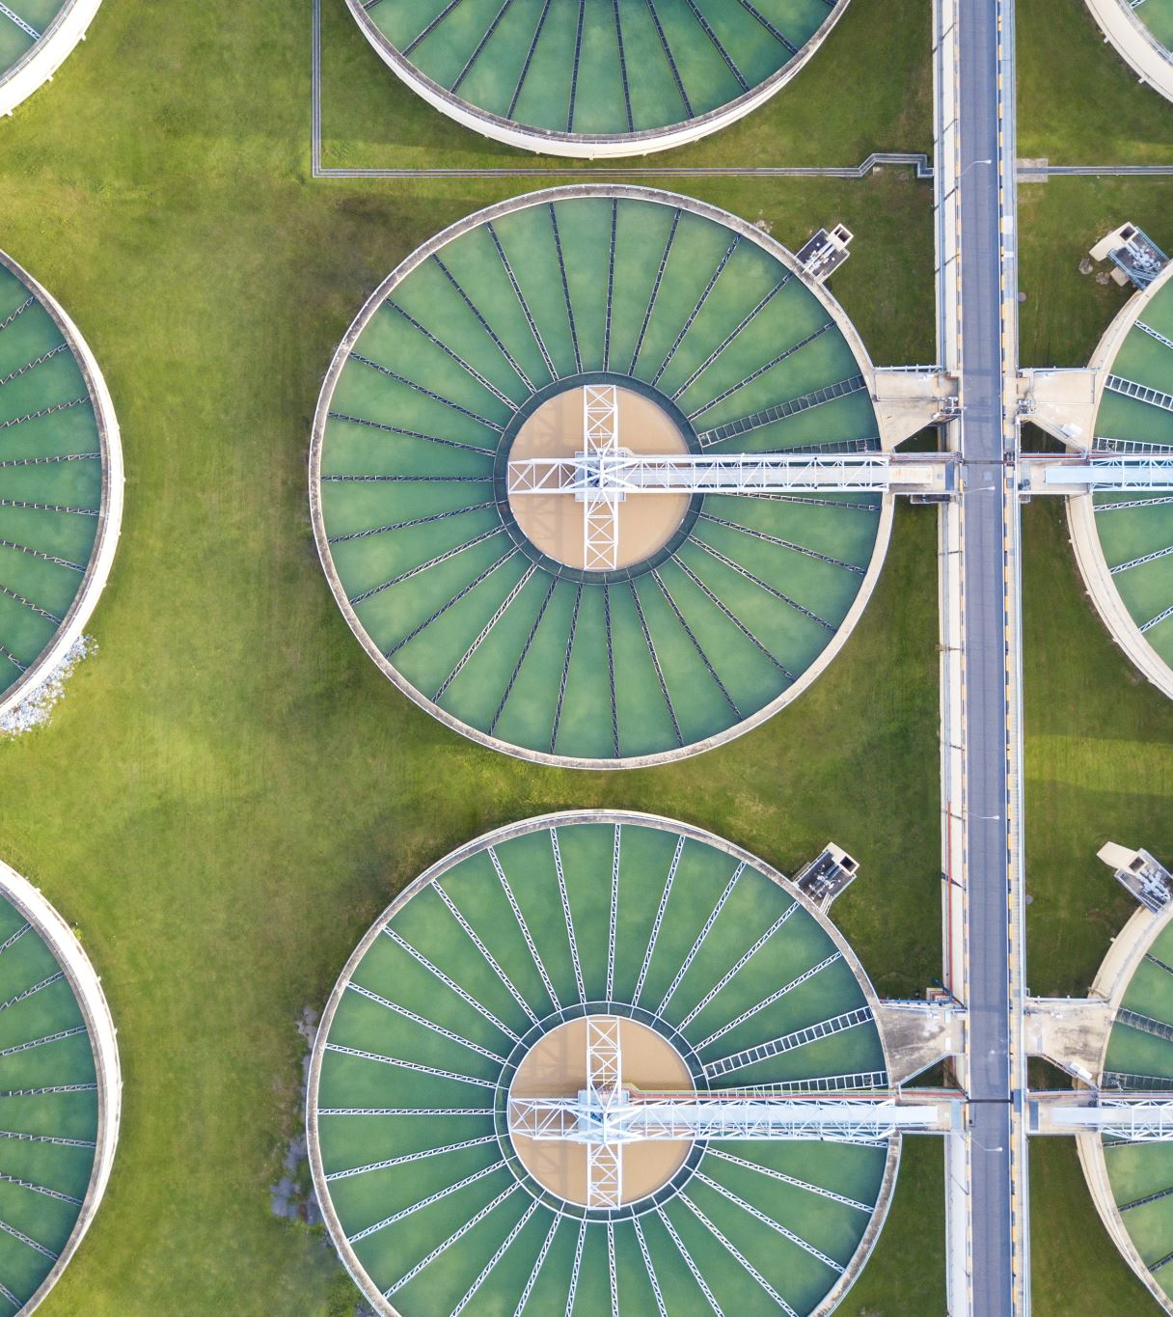
The biogas slurry left after digestion can be used as an organic fertilizer for community gardens or nearby farms, reducing the need for chemical fertilizers. Regular operation, maintenance, and training of local residents are essential to ensure the system runs efficiently.
By implementing biogas, Ojur Society can improve waste management, reduce environmental pollution, lower energy costs, promote clean energy use, and contribute to a more sustainable and self-reliant community.

Slide 12
