Slide 1
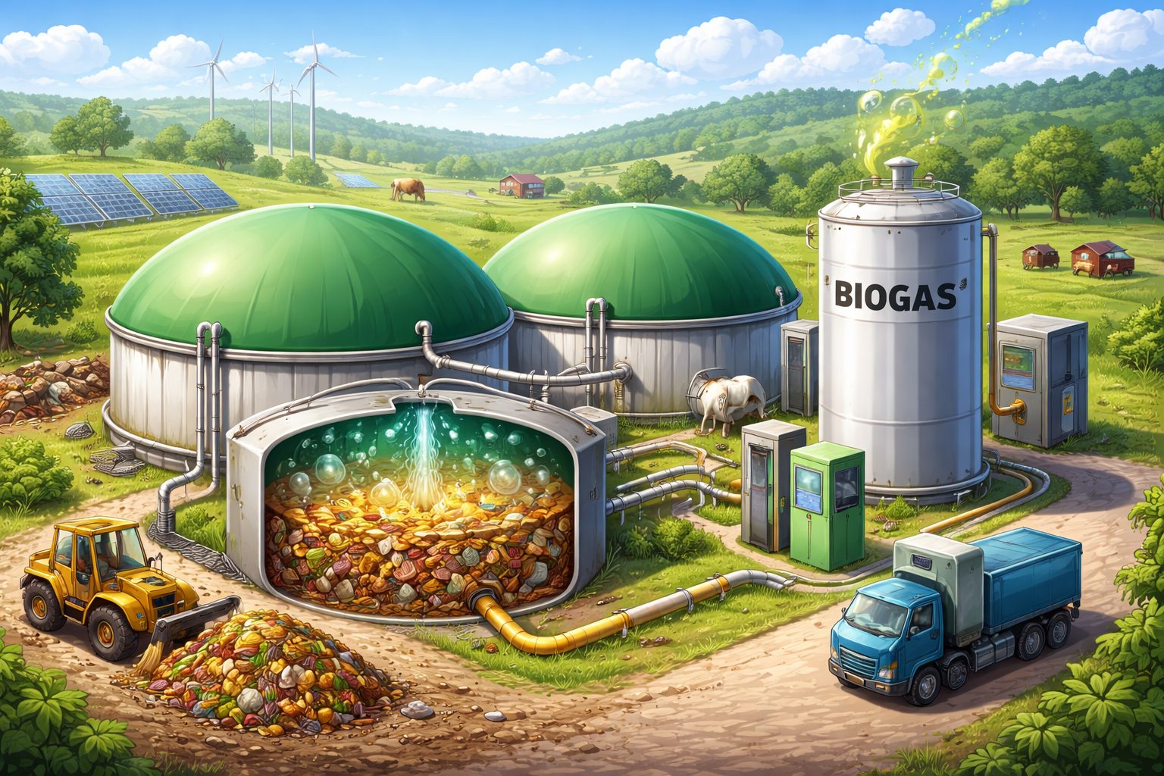
BIOGAS {NAME: ONYINYE PRECIOUS EZE}

Slide 2
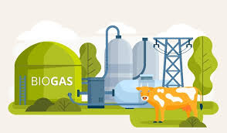
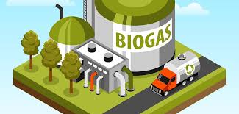
TURNING WASTES INTO CLEAN ENERGY

Slide 3
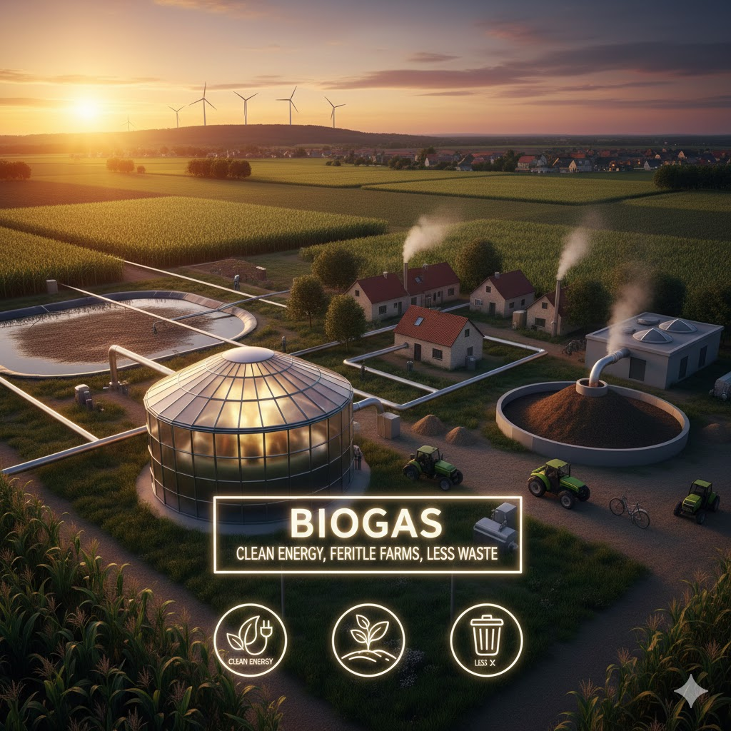

Slide 4
WHAT IS BIOGAS?
Biogas is a renewable source of energy produced when organic materials such as animal dung, human waste, food waste, and plant remains are broken down by microorganisms in the absence of oxygen (a process called anaerobic digestion).
The gas produced is mainly methane (CH₄) and carbon dioxide (CO₂), which can be used as fuel.
Because biogas comes from waste materials that can be replaced naturally, it is called renewable energy.

Slide 5
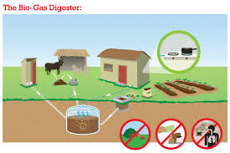
How Is Biogas Produced?
Biogas is produced in a special container called a biogas digester. The process involves four main stages:
Collection of waste – materials like cow dung, poultry waste, food scraps, and sewage are gathered.
Anaerobic digestion – the waste is fed into the digester where bacteria break it down without oxygen.
Gas formation – methane-rich biogas is released and stored.
Residue removal – the leftover slurry is removed and used as organic fertilizer.

Slide 6
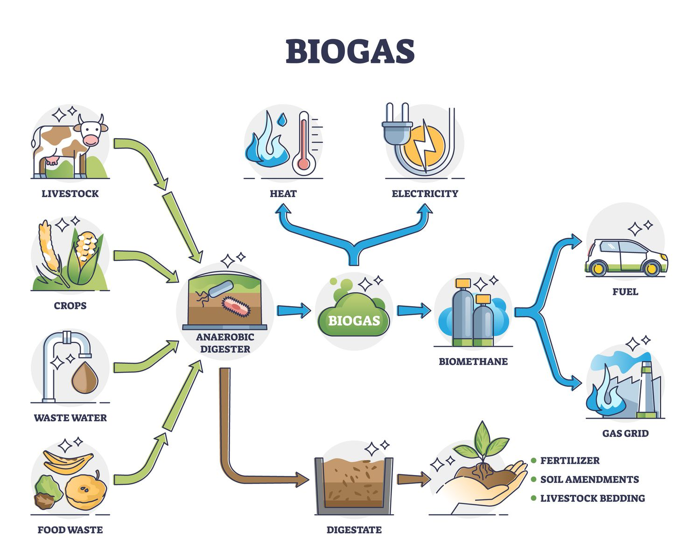

Slide 7
USES OF BIOGAS
Cooking (gas stoves)
Generating electricity
Heating homes and industries
Powering vehicles (after purification)
Producing organic fertilizer (biogas slurry)

Slide 8
ADVANTAGES OF BIOGAS
Renewable – it does not finish like fossil fuels
Reduces waste – turns waste into useful energy
Environmentally friendly – reduces pollution and greenhouse gases
Cheap in the long run – uses locally available materials
Creates jobs – in farming, waste management, and energy production
Improves sanitation – especially in rural areas

Slide 9
DISADVANTAGES OF BIOGAS
High initial cost of setting up digesters
Requires regular supply of organic waste
Gas production may reduce in cold seasons
Needs technical knowledge for maintenance

Slide 10

Biogas as a Sustainable Energy Source For India, Nigeria, Usa.

Slide 11
INDIA
India is one of the largest users of biogas, especially in rural areas.
How Biogas Helps India
Supports rural households: Millions of homes use small biogas plants for cooking.
Uses agricultural waste: Cow dung and crop residues are widely available.
Improves health: Reduces indoor air pollution from firewood.
Reduces fuel costs: Families spend less on LPG and kerosene.
Boosts farming: The leftover digestate improves soil fertility.
Biogas supports energy security, rural development, and environmental protection in India.

Slide 12
NIGERIA
Nigeria faces major energy challenges such as irregular electricity supply, heavy reliance on fuelwood, and environmental pollution.
How Biogas Can Help Nigeria
Nigeria has abundant organic waste: cow dung, poultry waste, cassava peels, food waste, and sewage.
Biogas can provide affordable cooking gas for rural and urban households.
It can reduce deforestation, especially in rural areas.
Schools, farms, markets, and prisons can use biogas for electricity and cooking.
Reduces pollution from open dumping of waste.
Biogas helps Nigeria move toward clean, affordable, and reliable energy, especially for villages and farms.

Slide 13
USA
The USA focuses on large-scale and advanced biogas systems, especially on farms and landfills.
How Biogas Helps the USA
Manages waste: Animal waste, sewage, and landfill waste are converted into energy.
Produces electricity and fuel: Biogas is used to generate electricity and renewable natural gas.
Reduces greenhouse gases: Capturing methane prevents it from escaping into the atmosphere.
Supports clean energy goals: Biogas supports climate change and sustainability policies.
Biogas helps the USA reduce carbon emissions, improve waste management, and support a clean energy economy

Slide 14
Environmental Benefits of Biogas
Reduces air pollution
Cuts down greenhouse gas emissions
Controls waste and sewage problems
Produces organic fertilizer
Helps fight climate change

Slide 15
CONCLUSION
Biogas is a powerful solution for sustainable energy. It turns waste into wealth, protects the environment, and provides clean energy.
For Nigeria, it helps solve power problems and waste issues.
For the USA, it supports clean energy and reduces emissions.
For India, it strengthens rural energy and improves living conditions.
Overall, biogas is a key renewable energy source for a cleaner and more sustainable future 🌱⚡

